Slide 1
Introduction to GitHub

Slide 2
What are Git and GitHub
Git is a free and open source distributed version control system designed to handle everything from small to very large projects with speed and efficiency.
It was created by Linus Torvalds in 2005 to develop Linux Kernel (the main component of a Linux operating system (OS)).

Slide 3
GitHub is an online hosting service for Git repositories.
GitHub is now the largest online storage space of collaborative works that exists in the world.

Slide 4
What is a Version Control System?
Version control is a system that records changes to a file or set of files over time so that you can recall specific versions later.
Changes are usually identified by a number or letter code, termed the “revision number”.
For example, an initial set of files is ”revision 1”.
When the first change is made, the resulting set is ”revision 2”, and so on.

Slide 5
Each revision is associated with a timestamp and the person making the change.
Revisions can be compared, restored, and with some types of files, merged.

Slide 6
VC: keeping a history
The life of your software/article is recorded from the beginning.
at any moment you can revert to a previous revision
the history is browseable, you can inspect any revision
when was it done?
who wrote it?
what was changed?
why?
in which context?
all the deleted content remains accessible in the history

Slide 7
VC: Working with others
VC tools help you to:
share a collection of files with your team
merge changes done by other users
ensure that nothing is accidentally overwritten
know who you must blame when something is broken

Slide 8
Branching
A way to write code without affecting the rest of your team.
You may have multiple variants of the same software, materialized as branches.
Finally, merge branches to integrate your changes.
Why use branching?
So you can’t push unstable code
Work independently
Still use remote version control
Only merge stable/functioning code

Slide 9
VC tools will help you to:
handle multiple branches concurrently
merge changes from a branch into another one

Slide 10
Working Locally
After everything is set up and you have “git” in your PATH environment variable, then the first thing you have to do is to config git with your name and email (workstation setup).
Enter these lines (with appropriate changes):
Git config --global user.name "John Smith"
Git config --global user.email jsmith@seas.upenn.edu
You only need to do this once.

Slide 11
Create a new Git Repository
Before starting, lets create a new directory where the git repository will live and cd into it:
mkdir mygitrepo
cd mygitrepo
Now we’re ready to initialize a brand new git repository.
git init
Then you can see a message as follows
Initialized empty Git repository in c:/………..

Slide 12
We can check for the current status of the git repository by using:
git status
Then you can see:
On branch master
No commits yet
nothing to commit (create/copy files and use "git add" to track)

Slide 13
Create and commit a new file
The next step is to create a new file and add some content to it.
touch hallo.txt
echo Hello, world! > hallo.txt
Again, checking for the status now reveals the following.
git status

Slide 14
Then, you can see the following on the screen:
On branch master
No commits yet
Untracked files:
(use "git add <file>..." to include in what will be committed)
hallo.txt
nothing added to commit but untracked files present (use "git add" to track)

Slide 15
To “register” the file for committing we need to add it to git using
git add hallo.txt
Checking for the status now indicates that the file is ready to be committed:
On branch master
No commits yet
Changes to be committed:
(use "git rm --cached <file>..." to unstage)
new file: hallo.txt

Slide 16
We can now commit it to the repository
git commit –m "Add my first file"
Then, you can see the following on your screen:
git commit -m “Add file hallo”
1 file changed, 1 insertion(+)
create mode 100644 hallo.txt

Slide 17
The staging area
Usual version control systems provide two spaces:
the repository
(the whole history of your project)
the working tree (or local copy)
(the files you are editing and that will be in the next commit)
Git introduces an intermediate space : the staging area (also called index).

Slide 18
The index stores the files scheduled for the next commit:
git add files : copy files into the index
git commit: commits the content of the index

Slide 19
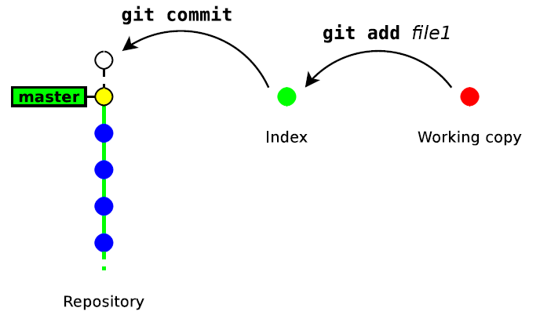
The staging Area

Slide 20
Update a file
echo blah blah blah > hallo.txt
git add hallo.txt
git commit -m "some changes“
Deleting files
git rm file
remove the file from the index and from the working copy
git commit –m “ text… “
commit the index

Slide 21
Branching & Merging
Branches are created for every new kind of functionality you’re going to add to your system.
They are normally deleted afterwards once the feature is merged back into the main integration branch (normally the master branch).
The advantage is that you can experiment with new functionality in a separated, isolated “playground”.

Slide 22
First create the new feature branch:
git branch my-feature-branch
Check the branch using the following command.
git branch
Then you can see the list of branches on the screen:
* master
my-feature-branch
The * in front of master indicates that we’re currently on that branch.

Slide 23
Lets switch to my-feature-branch instead:
git checkout my-feature-branch
Then you see the following on your screen
Switched to branch 'my-feature-branch‘
Again check the branch
git branch
Master
*my-feature-branch

Slide 24
Note you can directly use the following command to create and checkout a new branch in one step.
git checkout -b my-feature-branch

Slide 25
Now, lets modify one of our existing files.
echo "Hi" >> hallo.txt
Then commit it to our new branch.
git commit -a -m "modify file adding hi“
Then check the contents of your file using:
cat hallo.txt

Slide 26
This time the git commit -a -m command used to add and commit a modification in one step.
However, new files won’t be added this way and need an explicit git add as seen before.
Lets switch back to master and modify the same file there as well.
git checkout master

Slide 27
As expected, hallo.txt is unmodified. You can check it using the following command.
cat hallo.txt

Slide 28
Merging a Branch
Once you’re ready to merge back to master you can use the following command
git merge my-feature-branch
Deleting branches
Use the following command to delete a branch.
git branch -d branch name

Slide 29
Sharing/Synching your Repository
Ultimately we want to share our code, normally by synching it to a central repository.
For doing so, we have to add a remote.
Syntax: git remote add name url
name is identifying the remote repository
git remote add Mygitrepo URL
URL example (https://github.com/TsehayWasihun/Mygitrepo)

Slide 30
Sharing/Synching your Repository
To see whether you succeeded, simply type:
git remote –v

Slide 31
Pushing a new branch to the remote repository
Now we need to publish our local branch master to the remote repository. This is done like
git push -u Mygitrepo master
Syntax: (git push -u destination-repository ref[branch]) or
git push Mygitrepo master –force

Slide 32
Cloning
Similarly it works if you’d like to start from an existing remote repository.
The first step that needs to be done is to “checkout” the source code which is called cloning in Git terminology.
So we would do something like
git clone url [ directory ] of remote repository

Slide 33
git clone is a shortcut for the following sequence:
git init directory
cd directory
git remote add origin url
git fetch
git checkout master
In practice you will rarely use git init, git remote and git fetch directly, but rather use higher-level commands: git clone and git pull.

Slide 34
How to push a repository to GitHub
Step 1: Create a GitHub account
To be able to use GitHub, you will have to create an account first. You can do that on their website. https://github.com/

Slide 35
Step 2: Create a repository
You can click on the + symbol on the top right corner of the page then choose "New repository".
Give your repo a name then scroll down and click on "Create repository".

Slide 36
Step 3: Add and commit file(s)
Before we "add" and "commit" our files, you need to understand the stages of a file being tracked by Git.
Committed state
A file is in the committed state when all the changes made to the file have been saved in the local repo.
Files in the committed stage are files ready to be pushed to the remote repo (on GitHub).

Slide 37
Thank You

